Slide 1
TITLE: -SMART DUSTBIN
Abstract:
As there is a quick increment in the current populace squander the board has become the significant issue in the current world. So in this paper we are proposed another arrangement of squander the board utilizing an android versatile application with Bluetooth empowered keen dustbin. This android application controlled bot through the lines drawn on the floor. Generally the lines are predefined all through the way. The predefined ways may a white line on a dark surface or bad habit - versa. The keen dustbin identifies an individual utilizing IR sensor, if individual is distinguished consequently it will open the top of the dustbin and on the off chance that he moves away from the dustbin it will consequently close the top of the dustbin utilizing stepper engine. It can likewise have the option to identify sum of trash and smell present in the dustbin utilizing sensors. Assuming any one of these things arrived at the limit, it will consequently make an impression on the concerned individual through GSM module. Catchphrases—Android application, Bluetooth module, robot and Ultrasonic sensor, IR sensor, Gas sensor, dustbin.
Introduction:
The amount of waste produced and their potential effects rely upon diverse elements, including the level of modern turn of events, the manner by which squanders are dealt with, the current condition of the nearby condition and the limit of the getting media. Nowadays, urban areas with developing economies experience depleted waste assortment administrations, in adequately managed and uncontrolled dumpsites and the issues are exacerbating .The key issue of an insufficient waste administration is that the trash canister at open spots gets flooded well in advance before the initiation of the following cleaning process. Thus, we need such a framework, that can deracinate or if nothing else limit this issue somewhat. With the headway in innovation the opportunity has already come and gone that we use innovation for squander the executives frameworks. The Smart Dustbin is a solitary answer for the particular furthermore, curious issues in squander the board. In this proposed framework there are four dustbins and are meant by four area East, West, North and South, these dustbins are outfitted with minimal effort gadgets. This structure connotes the procedure through which the status of the trash in every dustbin can be checked by the administrator just as by the representative allocated to every dustbin at ordinary spans which will help in forestalling the bothersomeflood

Slide 2
of dustbins. The Wi-Fi module ESP8266 will go about as an interface between the equipment and the product while the ultrasonic sensors will sense the stature of the trash inside the dustbins. Not with standing this the East dustbin will be have the element of opening it's driven with a useful message when it identifies any movement and to draw individuals it will give an impetus by cleaning shoe with assistance of PIR sensor, APR module and IR sensor separately.In the current world numerous individuals are experiencing the irresistible maladies because of the inappropriate removal of waste what's more, it has become the most testing task is to Keep environmental factors clean. keeping this as the fundamental intension of our paper. We are in a quickly developing society where science and innovation sees a fast development and time has gotten the most important thing. Proposed framework structures some assistance at home for the individuals who can't help themselves.
Computerized shrewd dustbin individuals can have a control on it through the remote media utilizing Bluetooth innovation in the versatile. At whatever point the dustbin comes to the limit level consequently message will trigger on the concerned individual portable. So this procedure will stay away from the human mediation. The Internet of Things (IoT) is an idea wherein encompassing articles are associated through wired and remote systems without client intercession. In the field of IoT, the articles convey and trade data to offer progressed astute types of assistance for clients. This venture manages the issue of Waste administration in brilliant urban communities,where the trash assortment framework isn't streamlined. This venture empowers the associations to address their issues of shrewd trash the board framework. This framework permits the client to realize the fill level of every trash container in a region or city at unsurpassed, to give a financially savvy and efficient course to the truck drivers.
Targets The key examination destinations are as per the following:
This framework is having the option to computerize the strong waste observing procedure and the executives of the general assortment process utilizing IOT (Internet of Things).
This framework comprise of primary subsystems to be specific Smart Trash System(STS) and Smart Monitoring and Controlling Hut(SMCH). In the proposed framework, at whatever point the waste canister gets filled this is recognized by setting the circuit at the waste container, which communicates it to the recipient at the ideal spot in the region or spot.
In the proposed framework, the got signal demonstrates the waste
receptacle status at the checking and controlling framework.

Slide 3
Literature Survey:
Paper 1: SMART E-DUSTBIN
By:Chinmay Kolhatkar; Bhavesh Joshi ; Prachi Choudhari ; Dhruvin Bhuva
As the second most populous country in the world India face a major problem in waste management. As of now there are traditional waste management systems like periodic and routine clearing by the various civic bodies like the municipal corporation. But even though these routine maintenances is carried out we often come across overflowing garbage bins from which the garbage spills on to the streets. The smart city concept is still new in India, although it has received a lot of attention in few years when our present prime minister gave the idea of building 100 smart cities throughout India. Now, with the upcoming large number of smart cities, large numbers of responsibilities are also required to be fulfilled. The prime need of a smart lifestyle begins with cleanliness and cleanliness begins with dustbin. A society will get its waste dispatched properly only if the dustbins are placed well and collected well. The main problem in the current waste management system in most of the Indian cities is the unhealthy status of dustbins. In this paper we have tried to upgrade trivial and vital component of the urban waste management system, i.e. dustbin. The basic Idea behind project is to implement a smart way of handling the garbage in a smart way which is done by using the IOT protocol for transmitting the dustbin status wirelessly, which can generate email to notify to the concerned person that system isfilled with garbage and need to be replaced We have selected the Espresso chip which is a node MCU ESP8266 platform. The ultrasonic sensor will show the level of garbage filled in dustbin, whereas the proximity sensors will detect the obstacle present in front of dustbin to avoid collision. LCD interfacing has been done to show the current situation of dustbin.
PAPER 2: IoT-based Intelligent Waste Bin
BY: Moath Awawdeh ; Anees Bashir ; Tarig Faisal ; Irfan Ahmad ; Muhammad Khalil Shahid
The amount of the waste humans discards is rapidly increasing and will not be controlled without transformational changes. Waste management companies will be hugely impacted with such increments as they should provide resources for the collection of such waste with minimum or even zero income. This project aims to develop smart real-time waste management and monitoring system that optimized the resources and maximized the efficiency. The system is designed based on three main elements; Master station, Slave station, and Internet of things (IoT) platform. The master pin station gathers the data from the slave stations and transmits it to the IoT application for remote management and monitoring

Slide 4
purposes. The system is powered up by using solar panels. Four parameters are used for monitoring and managing the waste: temperature value, level in percentage reading, smoke detection, and the global positioning system (GPS) location. The development phase of the system is designed into two phases; system modeling and hardware implementation. This paper present the modeling phase of the system development.
PAPER 3: Efficient IOT Based Smart Bin for Clean Environment
BY: S. Murugaanandam ; V Ganapathy ; R Balaji
Dustbins are containers used for collecting household waste all around the world. In our day to day life, we dispose variety of waste materials categorized as industrial waste, sewage wastes, domestic wastes etc. Dustbins are used for collecting the domestic waste materials. Indoor dustbins are used to collect wastes from household, which are then disposed into the outdoor dustbins maintained by the Corporation or Municipality. Indoor dustbins are smaller in size, whereas municipal dustbins present outdoors are so big in size since it has to accommodate all the wastes from many household users in that area. Hence our main focus is on the dustbins placed outside every corner in the streets in order to keep the environment clean. Road side dustbins are not monitored and cleaned properly most of the times. In this paper we propose a new system for managing garbage within Smart Cities. This Efficient Waste disposal or Management System is considered as an essential for Modern Smart Cities (MSC). Internet of Things (IoT) can be implemented both in IS and MSC creating an highly developed proposal for future Operations. Special methods can be applied to enhance technology used for high Quality of Service (QoS) in our waste management system. Specifically, IoT components like sensors, detectors, and actuators are integrated into Intelligent System (IS) and Inspection systems for efficient waste management. We recommend a sophisticated IS for efficient waste management in Smart Cities. The proposed system is an automated alert basedsmart bin or garbage collection system and to alert the authorities like corporation or local waste disposal team. Using this, we can monitor the complete waste disposal in an efficient way.
PAPER 4: Cloud Based Smart Dustbin System for Metro Station
BY: Aayush Tripathi ; Chinmay Pandey ; Ankur Narwal ; Devashish Negi
RFID based Smart Dustbin System is a prototype model of next generation dustbin which would be highly equipped with sensors. This model mainly focuses on the security aspects. Some of bomb blasts during 2008 Serial blasts in Delhi were placed in dustbins. After the blasts dustbins were removed from all the metro stations in Delhi. This is because dustbins are an easy way to put the explosives. In

Slide 5
this paper we present a viable solution for dustbins at metro stations. We have built this prototype model of this smart dustbin system using RFID tags, RFID reader, Ultrasonic sensor, geared motors, servo motors, Arduino UNO, raspberry-pi and solar panel for power supply. The system uses cloud based monitoring system for garbage monitoring. With the use of cloud based system there is no need of routine checking of dustbins. To make the system ecofriendly and preserve carbon neutral footprint of metro we are using miniature solar panel for power supply.
PAPER 5:-IOT ENABLED DUSTBINS
BY: Sahil Mirchandani ; Sagar Wadhwa ; Preeti Wadhwa ; Richard Joseph Nowadays, waste management is one of the problems on which million of
dollars are spent worldwide. the key issue in waste management is waste collection
and sorting. Also, one of the issues in the waste management is that the garbage bin
at public places gets overflowed in advance before the commencement of the next cleaning process. This, in turn, leads to various hazards such as bad odor & ugliness to that place which may be the root cause for the spread of various diseases. To tackle this problem, we propose the IOT enabled dustbins in this paper. these bins, use RFID tags for tracking of the wastes linked with a web-based online system and according to the weight of waste added, host server calculates the points and updates in the database of virtual wallet. Also, it measures the fullness of the dustbins and updates the status of each dustbin on the municipal server. It notifies them when the dustbin is full and provides the shortest route to empty all the dustbins based on the capacity of the municipal waste loading vehicles. The Capacity of trucks is calculated and updated each time according to the number of dustbins serviced by the trucks, as soon as it completes a route assigned to it. Furthermore, the user is assisted in material waste classification through our application and also the smart bin knows its content and can report back to the rest of the recycling chain about its contents. Our system, target two crucial problems, cost efficiency in waste sorting and waste collection processes.
PAPER 6:- IOT based smart garbage alert system using Arduino UNO
BY: N. Sathish Kumar ; B. Vuayalakshmi ; R. Jenifer Prarthana ;A. Shankar Waste management is one of the primary problem that the world faces
irrespective of the case of developed or developing country. The key issue in the
waste management is that the garbage bin at public places gets overflowed well in advance before the commencement of the next cleaning process. It in turn leads to various hazards such as bad odor & ugliness to that place which may be the root cause for spread of various diseases. To avoid all such hazardous scenario and maintain public cleanliness and health this work is mounted on a smart garbage

Slide 6
system. The main theme of the work is to develop a smart intelligent garbage alert system for a proper garbage management. This paper proposes a smart alert system for garbage clearance by giving an alert signal to the municipal web server for instant cleaning of dustbin with proper verification based on level of garbage filling. This process is aided by the ultrasonic sensor which is interfaced with Arduino UNO to check the level of garbage filled in the dustbin and sends the alert to the municipal web server once if garbage is filled. After cleaning the dustbin, the driver confirms the task of emptying the garbage with the aid of RFID Tag. RFID is a computing technology that is used for verification process and in addition, it also enhances the smart garbage alert system by providing automatic identification of garbage filled in the dustbin and sends the status of clean-up to the server affirming that the work is done. The whole process is upheld by an embedded module integrated with RF ID and IOT Facilitation. The real time status of how waste collection is being done could be monitored and followed up by the municipality authority with the aid of this system. In addition to this the necessary remedial / alternate measures could be adapted. An Android application is developed and linked to a web server to intimate the alerts from the microcontroller to the urban office and to perform the remote monitoring of the cleaning .
PAPER 7:- Smart garbage monitoring and clearancesystem using internet of
things
BY: S. Vinoth Kumar; T. Senthil Kumaran ; A. Krishna Kumar ; Mahantesh Mathapati
The increase in population, has led to tremendous degradation in the state of affairs of hygiene with respect to waste management system. The spillover of waste in civic areas generates the polluted condition in the neighboring areas. It may aggravate numerous severe diseases for the nearby people. This will humiliate the appraisal of the affected area. For eliminating or mitigating the garbage's and maintains the cleanness, it requires 'smartness based waste management system. This paper is proposed IOT based smart waste clean management system which checks the waste level over the dustbins by using Sensor systems. Once it detected immediately this system altered to concern authorized through GSM/GPRS. For this system used Microcontroller as an interface between the sensor system and GSM/GPRS system. To monitor and integrate an android application is developed for the desired information which is related to the various level of waste in different locations. This is ensued the greenish in the environment and support for swachh bharat for cleanness.

Slide 7
PAPER 8:- IoT based Waste Collection Management System for Smart Cities
BY: Megha S. Chaudhari ; Bharti Patil ; Vaishali Raut
As of late, it is seen that dustbins set at a different spots like open places, for example, healing centers, instructive Institutes and Industries are flooding. This flooding of refuse canisters make unhygienic condition which can spread the sicknesses .Also fast increment in populace squander offer ascent to inappropriate waste administration. To maintain a strategic distance from this circumstance, we proposed new framework "Smart City Garbage Collection and Monitoring System". In the recent decades, Urbanization has increased tremendously. In the meantime there is an expansion in waste creation. Waste management has been a pivotal issue to be considered. This paper is a way to deal with achieve this incredible inspiration. In this paper, smart bin is built on a microcontroller based platform Raspberry pi Uno board which is interfaced with GSM modem and Ultrasonic sensor and also the weight Sensor which is used for calculating the weight of the dustbins. The weight sensor is placed at the bottom of the dustbins which will measure the weight of the dustbins and also The Ultrasonic sensor is placed at the top of the dustbin which will read the status of the dustbin. The threshold limit is set as 10cm. Raspberry will be programmed in such a way that when the dustbin is being filled, the remaining height from the threshold height will be displayed. When the junk achieves the limit level ultrasonic sensor will trigger the GSM modem which will persistently caution the required expert until the trash in the dustbin is squashed. As indicated by the area, expert will sends the message to the separate administrator; waste vehicle can gather the refuse, which is finished with the assistance of robot component.
PAPER 9:-Iot Based Garbage Monitoring and Clearance Alert System
BY: Himadri Nath Saha ; Sourav Gon ; Annesha Nayak ; Samabrita kundu ; Sumandrita Moitra
With the continuous increase in population, garbage management becomes most alarming concern of today's world mainly the countries with high population rate. Excess garbage in disposal area or overflow of garbage in the dustbin may aggregate different harmful diseases for the neighboring people. Hence the disposal and clearance and monitoring of garbage needs “IoT based smart Garbage Monitoring and Clearance Alert System” which will help to maintain hygiene and cleanliness of surrounding area. This paper proposed the IoT based smart garbage monitoring and clearance alert system in which RGB led lights will be attached with the bins as the indicator of the garbage level of bin at that moment from which users will get the idea of the level of garbage inside the bin. After disposal of garbage, the sensor present within the bin will monitor the level of the garbage.

Slide 8
When the garbage level will meet the maximum capacity level it will send alert to the municipality and if the level is not crossed but the garbage is being cleared for more than two days then also a clearance alert will be generated. An android app is developed to send the alerts from the microcontroller used in the system to the management. The whole procedure is reducing the human labor of monitoring. The total system will be connected by WIFI.
PAPER 10:- Implementation of an smart waste managementsystem using IoT
BY:P Haribabu ; Sankit R Kassa ; J Nagaraju ; R Karthik ; N Shirisha ; M Anila Waste collection services, today, are exhausted and unable to bear the burden
of rising cities. It is one of the biggest ongoing challenges, being faced by developing
economies, where a large variety of goods ranging from cars to metal and hardware end up in inadequately managed and uncontrolled dumpsites, spreading diseases and increasing pollution. However, most of these plans have been able to manage waste once it has already been created. We, therefore, propose a system through a mobile application associated with a Smart Trash Bin. The main aim of this application is to reduce human resources and efforts along with the enhancements of a smart city vision. At regular intervals dustbin will be squashed. Once these smart bins are implemented on a large scale, by replacing our traditional bins present today, waste can be managed efficiently as it avoids unnecessary lumping of wastes on roadside. Breeding of insects and mosquitoes can create nuisance around promoting unclean environment. This may even cause dreadful diseases.
PAPER 11:-An Intelligent Bin Management System Design for Smart City using GSM Technology
BY: Bandana Prasad ; Sidhant Dalmia ; Sindhu Dasari ; Namita Arya
In our society, the trashcans are placed at public places in the cities and it is overflowing due to tremendous growth of the waste production every day. It leads to spreading of some diseases and
proliferating human ailment, to avoid such situation we have designed “Intelligent Bin Management System for Smart City using Mobile Application”. The main objective of our paper is to monitor and manage the waste materials and create awareness about the current system of management activities. The conventional way of manually monitoring the waste in waste bins is extremely sluggish process and utilizes more human efforts and time which can easily be avoided with present technologies. This paper practically demonstrates how internet of things (IOT) Integration with data access networks and electronics engineering can contribute to enhance cities management systems. We have presented a waste collection solution

Slide 9
based on providing intelligence to trashcans, by using an Internet of things (IOT) prototype embedded with sensors, which can read, collect and transmit trash volume data over the GSM network.
PAPER 12:- Smart Waste Collection Monitoring and Alert System via IoT
BY: Zainal Hisham Che Soh ; Mohamad Azeer Al-Hami Husa ; Syahrul Afzal Che Abdullah ; Mohd Affandi Shafie
The uncollected waste material when the waste bin is full is a common problem nowadays. Thus, an efficient waste management for the waste material is essential in ensuring a clean and green surrounding environment. This paper presents an Internet of Things (IoT) based Smart Waste Collection Monitoring and Alert System to monitor the waste material at the selected site of garbage collection area. The system is implemented using an ultrasonic sensor which is connected to Arduino UNO as to monitor waste bin garbage level. In this system, waste bin depth level will be sent via Arduino Ethernet Shield with an Internet connection to the Ubidots IoT Cloud. The Ubidots store the collected waste bin level data into IoT database and display the waste bin depth level on online dashboard for realtime visualization. The Ubidots Event manager invoke a notification alert to garbage collector mobile phone via a SMS when the waste bin is nearly filled for immediate waste collection. Therefore, the waste collection became more effective and systematic.
PAPER 13:- Automation of Smart waste management using IoT to support
“Swachh Bharat Abhiyan
BY: Bharadwaj B ; M Kumudha ; Gowri Chandra N ; Chaithra G
“Swachh Bharat Abhiyaan” is a national campaign initiated by the Government of India, which covers 4,041 cities and towns, to clean the streets, roads and infrastructure of the country. The main motto of the mission is to cover all the rural and urban areas of the country. With proliferation of Internet of Things (IoT) devices such as Smartphone & sensors, this paper describes the effective dry and wet dirt collection using Embedded System. The main motto of the application is collection of dry and wet waste separately which is placed in a conveyor belt on which the dry waste collected dust bins are placed left side and wet waste collected bins on right side. The system will get the input through the dust collecting person through switches and sends signal to the Micro controller unit using RF technology and that makes the H-bridge to rotate conveyor belt. When the belt starts rotating clockwise the dust bin's lid is automatically closed, simultaneously the waste is
dumped into the underground garbage container placed at the ground floor. Here IoT module is used to control and monitor the waste and the information will be sent

Slide 10
to the particular organization and the common man. The mobile app shows the collection of waste and the particular date and arrival time of the vehicle.
PAPER 14:- A Smart Dustbin using Mobile Application
BY: Anilkumar C.S., Suhas G, Sushma S
As there is a rapid increase in the present population waste management has become the serious problem in the current world. So in this paper we are proposed a new system of waste management using an android mobile app with Bluetooth enabled smart dustbin. This android application controlled bot
through the lines drawn on the floor. Usually the lines are predefined throughout the path. The predefined paths may a white line on a black surface or vice
-versa. The smart dustbin detects a person using IR sensor, if person is
detected automatically it will open the cap of the dustbin and if he moves away from the dustbin it will automatically close the cap of the dustbin using stepper motor. It can also be able to detect amount of garbage and odour present in the dustbin using sensors. If any one of these things reached the threshold, it will automatically send a message to the concerned person through GSM module. Keywords— Android application, Bluetooth module, robot and Ultrasonic sensor, IR sensor, Gas sensor, dustbin.

Slide 11
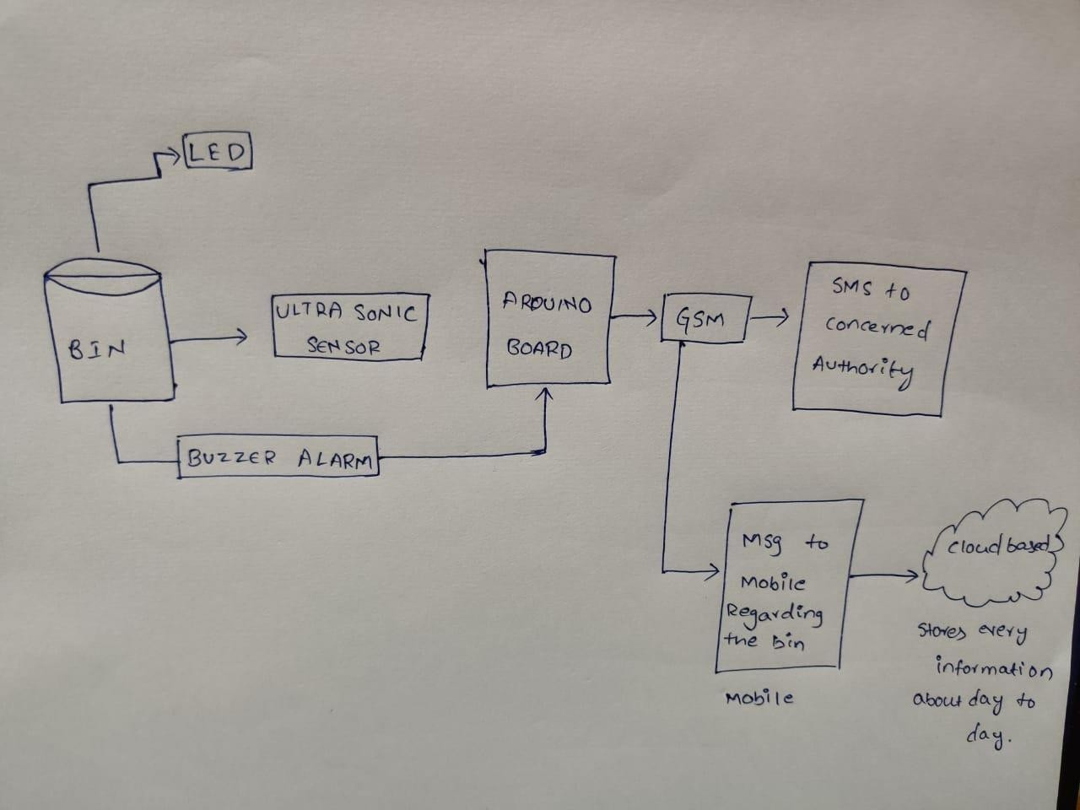
UML DIAGRAM:
SMART DUSTBIN:
This endeavor Smart Dustbin is about another plan utilized in the city junk dustbins where propose the focal point of board for speedy gathering of garbage. This dustbin is moreover expected to pack the refuse intermittently consequently keeping the pointless including of dustbin's space by light weighted at this point space having rubbish particles like wipes, etc. A leaf switch is just barely gotten by the waste when it accomplishes a particular level and an Arduino Uno is redone with the end goal that when the garbage accomplishes this particular level, hint is given to the focal center point through shining of LED.
An incorporated arrangement of Wi-Fi modem, IoT, GSM, Ultrasonic Sensor is presented for proficient and financial trash assortment. The created framework gives improved information base to trash assortment time and waste sum at every area. He dissected the arrangements as of now accessible for the execution of IoT. By executing this undertaking, at that point will dodge over streaming of trash from the holder in local location which is already either stacked physically or with the assistance of loaders in conventional trucks.

Slide 12
It can consequently screen the trash level and send the data to assortment truck. The advancements which are utilized in the proposed framework are sufficient to guarantee the useful and ideal for strong trash assortment measure checking and the executives for green condition . Trash Management is a major issue for everybody to require activity across it right away.A framework that ready to watch the distinctive sort trash is tossed into dustbin by utilizing sensors. At the point when dustbin is full or flooded then ultrasonic sensor is identified the level trash in dustbin or some wet trash is tossed into dustbin is recognized by the Moisture sensor or some upsetting smell just as poisonous gases are created then gas sensor is give the data.
This sensors yield is given to the Micro-regulator. In this framework there are two innovations are utilized like Zigbee and Global framework for Mobile correspondence (GSM). These two advances are utilized for remotely information transmission over significant distance. PIC regulator is utilized to send the Message to cleaning authority who clean the dustbin by utilizing GSM. It is an ongoing framework; the dustbin status is appeared on PC by utilizing GUI. This sort of framework is utilized in school grounds, workplaces and numerous spots where it is appropriate.
CLASSIFICATION :
Isolation of waste is the first and most significant advance in squander the board and ecological safeguarding. It takes into consideration better removal of waste and supports all the more reusing and reuse of issue. Absence of isolation is the underlying driver of stopped up landfills, obstructed depletes, soil and water contamination and can frustrate the whole cycle of garbage removal, reusing and reuse. To diminish the exertion needed to isolate squander, numerous urban areas and air terminals have utilized containers with allotments for various sorts of waste. It has, be that as it may, neglected to work, since clients don't require the push to discard the waste accurately.
We basically need a method of to isolate squander without human intercession. We propose a shrewd dustbin which does the previously mentioned task. The dustbin isolates squander into 3 classes: Recyclables ( Plastic, paper and glass), Metals and Organic Waste. These dustbins require least adjustment to the current containers. The dustbin can isolate different burns through at a time and has underlying highlights to recognize when the waste receptacle is approaching assortment so as to make the concerned specialists aware of void the canisters.

Slide 13
An air partition instrument (Brushless DC engine and a propeller) isolates the falling waste things dependent on their thickness and power applied by moving air. For recognizing the passage of waste, a Laser-LDR pair is utilized at the container mouth. The isolated waste will be gathered in a detachment zone. The area of the loss in the partition zone is resolved utilizing a camera with the assistance of Image Processing. The camera is mounted over the partition zone and identies the area of the loss in the zone. The directions of each waste is then used to push the waste independently out of the partition zone for identication and isolation. The waste is pushed out of the division zone with the assistance of an arm mounted on a servo engine. After this, the burn through is driven each in turn into the waste gatherer. The waste is then identied with the assistance of a Capacitive and Inductive Proximity sensor. The capacitive sensors help recognize natural waste while the Inductive Sensor distinguishes metallic waste. A waste thing which isn't recognized by both of the two sensors will be sorted as Recyclable waste (i.e glass, paper and plastic).
The dustbin is partitioned into 3 compartments-Recyclables, Metal and Biodegradable waste. The waste gatherer is normal in both classication and removal instrument. Here, the waste authority functions as a transporter of specied trash to its particular receptacle. The waste authority is mounted on a lead screw with the assistance of a servo engine. When the waste is identied, the waste authority moves the loss to its fitting receptacle with the assistance of the lead screw.
Assessed effect of Smart Bin:
7.5% decrease in sum spent every day on removal of waste
7.5% decrease in complete waste sent day by day to landfills
1.2 lakh rupees produced every day from reusing plastics as it were
Break even time of 2.5 years

Slide 14
SIMULATION CODE :
#include <Servo.h>
Servo servoMain; // Define our Servo int trigpin = 4;
int echopin = 3; int distance; float duration; float cm;
void setup()
{
servoMain.attach(5); // servo on digital pin 10 pinMode(trigpin, OUTPUT); pinMode(echopin, INPUT);
}
void loop()
{
digitalWrite(trigpin,
LOW);
delay(2); digitalWrite(trigpin, HIGH);
delayMicroseconds(10); digitalWrite(trigpin, LOW);
duration = pulseIn(echopin, HIGH); cm = (duration/58.82);
distance = cm;
if(distance<30)
{
servoMain.write(180); // Turn Servo back to center position (90 degrees)
delay(3000);
}
Else
{
servoMain.write(0); delay(50);
}

Slide 15
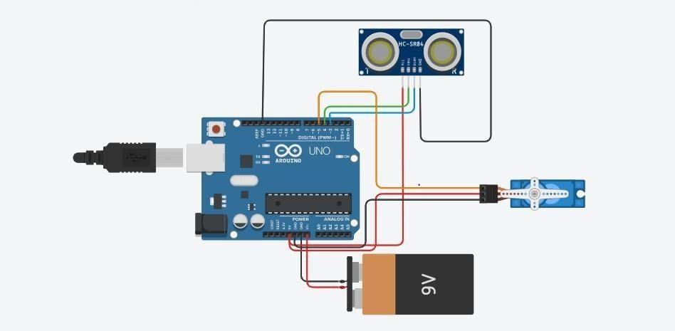
SIMULATION :
REFERENCES:
[1] : C. Kolhatkar, B. Joshi, P. Choudhari and D. Bhuva, "Smart E- dustbin," 2018 International Conference on Smart City and Emerging Technology (ICSCET), Mumbai, 2018, pp. 1-3, doi: 10.1109/ICSCET.2018.8537245.
[2] : M. Awawdeh, A. Bashir, T. Faisal, I. Ahmad and M. K. Shahid, "IoT-based Intelligent Waste Bin," 2019 Advances in Science and Engineering Technology International
Conferences (ASET), Dubai,
United Arab Emirates, 2019, pp. 1-6, doi:10.1109/ICASET.2019.8714406.

Slide 16
: S. Murugaanandam, V. Ganapathy and R. Balaji, "Efficient IOT Based Smart Bin for Clean Environment," 2018 International Conference on Communication and Signal
Processing (ICCSP), Chennai, 2018, pp. 0715-0720, doi:10.1109/ICCSP.2018.8524230.
: A. Tripathi, C. Pandey, A. Narwal and D. Negi, "Cloud BasedSmart Dustbin System for Metro Station," 2018 3rd International Conference On Internet of Things: Smart Innovation and Usages (IoT- SIU), Bhimtal, 2018, pp. 1-4, doi: 10.1109/IoT-SIU.2018.8519845.
: S. Mirchandani, S. Wadhwa, P. Wadhwa and R. Joseph, "IoT enabled dustbins," 2017 International Conference on Big Data, IoT and Data Science (BID), Pune, 2017, pp. 73-76, doi: 10.1109/BID.2017.8336576.
: N. S. Kumar, B. Vuayalakshmi, R. J. Prarthana and A. Shankar, "IOT based smart garbage alert system using Arduino UNO,"2016 IEEE Region 10 Conference (TENCON), Singapore, 2016, pp. 1028- 1034, doi: 10.1109/TENCON.2016.7848162.
: S. V. Kumar, T. S. Kumaran, A. K. Kumar and M. Mathapati, "Smart garbage monitoring and clearance system using internet of things," 2017 IEEE International Conference on Smart Technologies and Management for Computing, Communication, Controls, Energy and Materials (ICSTM), Chennai, 2017, pp. 184-189, doi: 10.1109/ICSTM.2017.8089148.
:M. S. Chaudhari, B. Patil and V. Raut, "IoT based Waste Collection Management System for Smart Cities: An Overview," 2019 3rd International Conference on Computing Methodologies and Communication (ICCMC), Erode, India, 2019, pp. 802-805, doi: 10.1109/ICCMC.2019.8819776.
: H. N. Saha, S. Gon, A. Nayak, S. kundu and S. Moitra, "Iot Based Garbage Monitoring and Clearance Alert System," 2018 IEEE 9th Annual Information Technology, Electronics and Mobile Communication Conference (IEMCON), Vancouver, BC, 2018, pp. 204-208, doi: 10.1109/IEMCON.2018.8614840.
: P. Haribabu, S. R. Kassa, J. Nagaraju, R. Karthik, N. Shirisha and
M. Anila, "Implementation of an smart waste management system using IoT,"
2017 International Conference on Intelligent Sustainable Systems (ICISS), Palladam, 2017, pp. 1155-1156, doi: 10.1109/ISS1.2017.8389367.
: B. Prasad, S. Dalmia, S. Dasari and N. Arya, "An Intelligent Bin Management System Design for Smart City using GSM Technology," 2018 7th International Conference on Reliability, Infocom Technologies and Optimization (Trends and Future Directions) (ICRITO), Noida, India, 2018, pp. 557-563, doi: 10.1109/ICRITO.2018.8748636.
: Z. Hisham Che Soh, M. Azeer Al-Hami Husa, S. Afzal Che Abdullah and M. Affandi Shafie, "Smart Waste Collection Monitoring and Alert System via IoT," 2019 IEEE 9th Symposium on Computer Applications & Industrial Electronics (ISCAIE), Malaysia, 2019, pp. 50- 54, doi: 10.1109/ISCAIE.2019.8743746.
: Bharadwaj B, M. Kumudha, Gowri Chandra N and ChaithraG, "Automation of Smart waste management using IoT to support “Swachh Bharat Abhiyan” - a practical approach," 2017 2nd International Conference on Computing and Communications

Slide 17
Technologies (ICCCT), Chennai, 2017, pp. 318-320, doi: 10.1109/ICCCT2.2017.7972300.
[14] :International Journal of Innovative Technology and Exploring Engineering (IJITEE) ISSN: 2278-3075, Volume-8 Issue-11, September 2019
aamir attar, 2aadil ansari, 3abhishek desai, 4shahid khan, 5dipashri sonawale (2017) "line adherent and hindrance shirking bot utilizing arduino" International Journal of Advanced Computational Designing and Networking, ISSN: 2320-2106, Volume-5, Issue-4, Aprl.- 2017
Kazi Mahmud Hasan, Abdullah-AI-Nahid, Abdullah Al Mamun (2012)"Implementation Of Autonomous Line Follower Robot" IEEE/OSA/IAPR International Conference on Informatics, Hardware and Vision 978-1-4673-1154- 0112/$31.00 ©20 12 IEEE.
Deepak Punetha, Neeraj Kumar, Vartika Mehta (2013) "Advancement also, Applications of Line Following Robot Based Health Care The board System" International Journal of Advanced Research in PC Engineering and Technology (IJARCET) Volume 2, Issue 8, August 2013 pp ISSN: 2278 – 132
Anil Kumar C.S Dr.Venkata Siva Reddy.R(2017) "Brilliant Solid and Fluid Waste Management Using IoT" CiiT International Journal of Programmable Device Circuits and Systems, Vol 10, No 1, January 2018 ISSN: 0974 – 9624
Gopal Kirshna Shyam1,Sunilkumar S. Manvi2,Priyanka Bharti3 (2017)"Smart Waste Management utilizing Internet-of-Things (IoT)" 2017
Second International Conference On Computing and Correspondences Technologies(ICCCT'17)
Bharadwaj B, M Kumudha, Gowri Chandra N " Chaithra G(2017) "mechanization of brilliant waste administration utilizing iot to help swachh bharat abhiyan a reasonable methodology" 2017 Second International Gathering On Computing and Communications Technologies(ICCCT'17)
7.Jan Nádvorník, Pavel Smutný (2014)"Remote Control Robot Using Android Mobile Device" 2014 fifteenth International Carpathian Control Gathering (ICCC) 374, 978-1-4799- 3528-4/14/$31.00 ©2014 IEEE
FRISCHKNECHT, Claudia and OTHER, Thomas. LEGO Mindstorms NXT, Next Generation. [online]. Swiss Federal Institute of Innovation Zurich, 2006. [cit. 2014-01-18]

